Slide 1


Integrity Nominee Functionality
Keith Labedz
U.S. Office of Government Ethics

Slide 2
Agenda
Overview of the Nominee workflow
Assigning a Nominee Report
Completing the initial draft
Releasing the initial draft
OGE and agency review of the draft
Preclearance to certification
After certification

Slide 3
Nominee workflow

Slide 4
PPO adds filer and assigns report
filer (or
designee)
fills out draft report
PPO releases draft report to WHCO
WHCO releases draft to OGE and agency
OGE enters nomination date in Integrity
OGE preclears draft
staff reviews report and works with filer
OGE/agency assigns draft to staff
filer formally files report
agency certifies report
OGE certifies report
OGE prints
final
report

Slide 5
Assigning a report

Slide 6
Assignment steps
PPO adds the Nominee as a filer to the PPO Group.
If the filer is an existing Integrity user, the Nominee is added using the filer’s existing MAX ID.
If the filer is not an existing Integrity user, the Nominee is added using a cloaked ID.
PPO then makes the assignment through the Manage Assigned Reports page.
Only the filer and PPO can see the draft report at this point.

Slide 7
Completing the initial draft

Slide 8
Login
Existing Integrity user:
Filer logs in using his/her existing MAX ID and password.
Cloaked ID:
Filer will receive an email notice with the cloaked ID.
To set a password for this ID, filer should:
Click the link in this email notice from Integrity.
On the MAX.gov password page, click the request reset button.
Wait for an email from MAX.gov.
Click the link in this email notice from MAX.gov.
On the password page, enter a password.

Slide 9
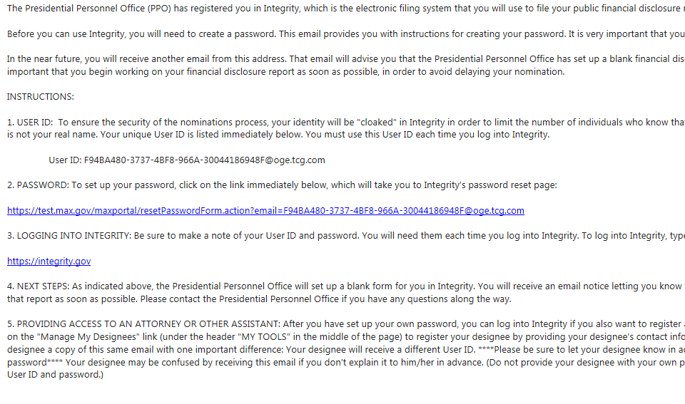

Slide 10
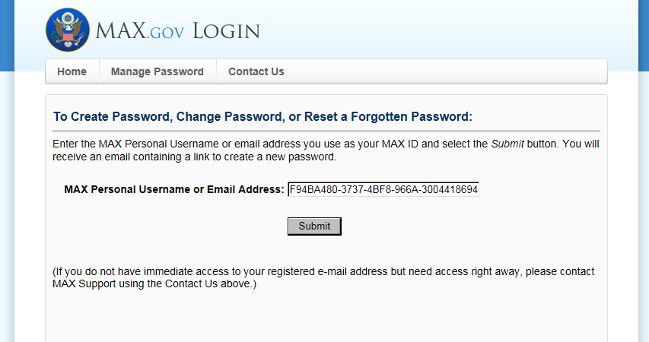

Slide 11
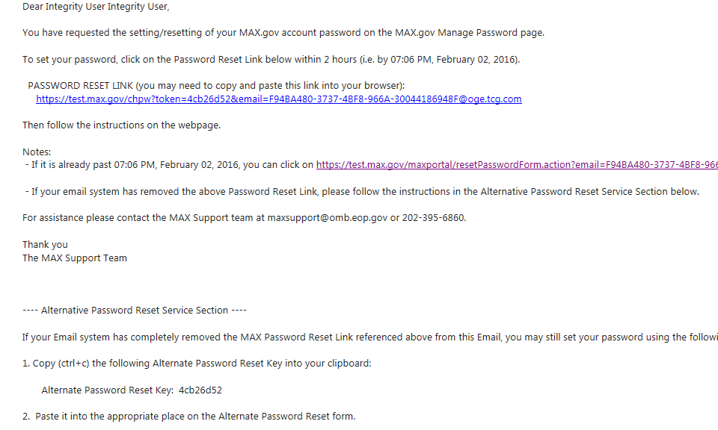

Slide 12
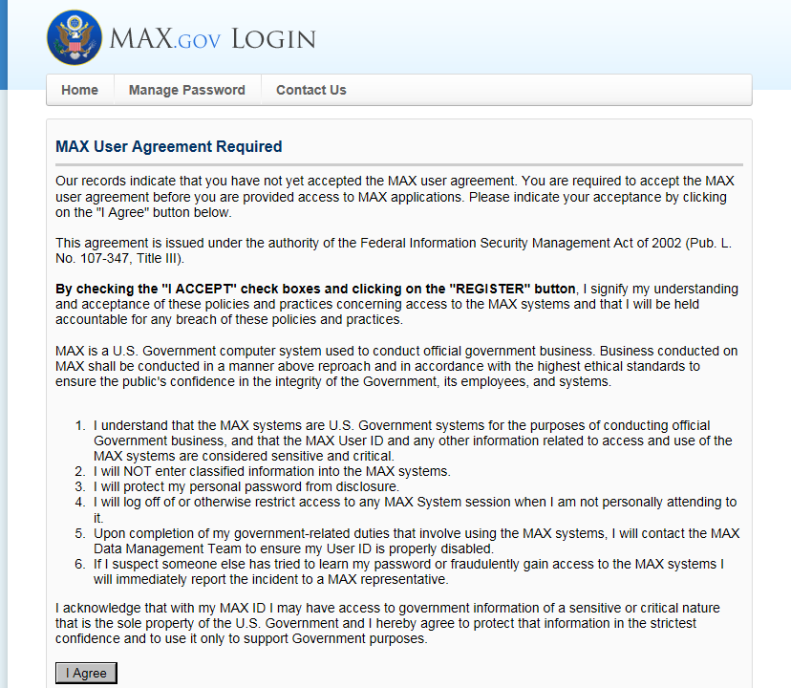

Slide 13
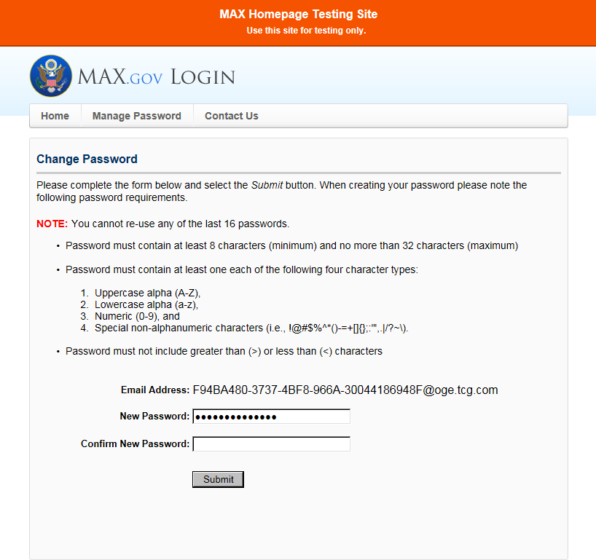

Slide 14
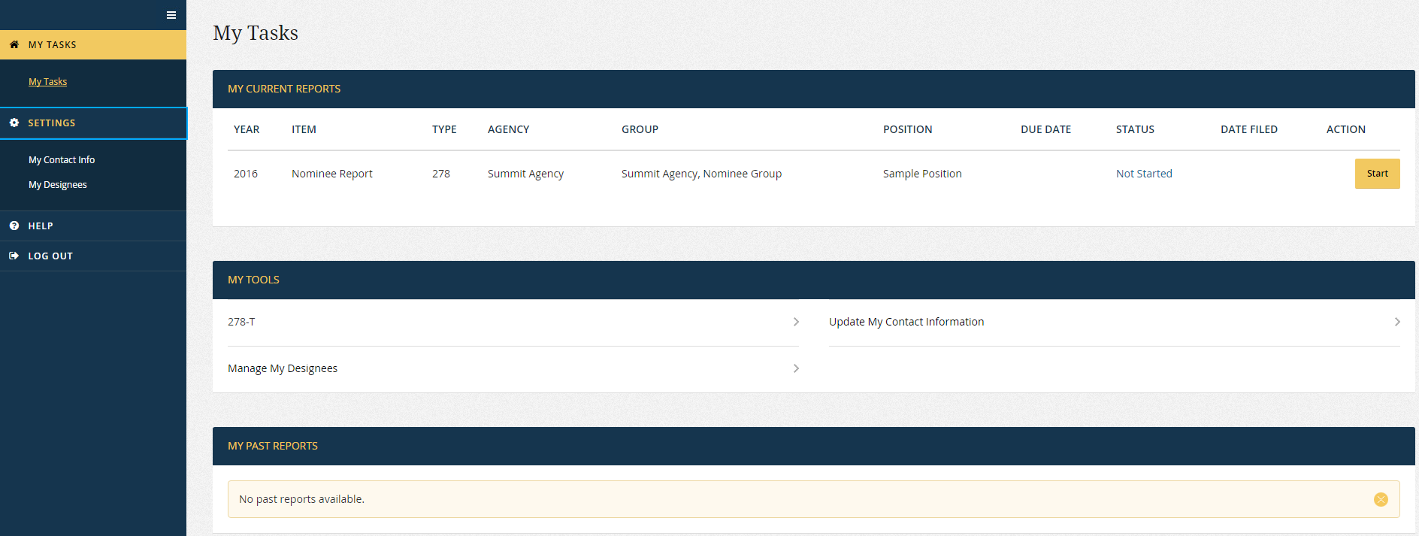
Adding a designee 1

Slide 15
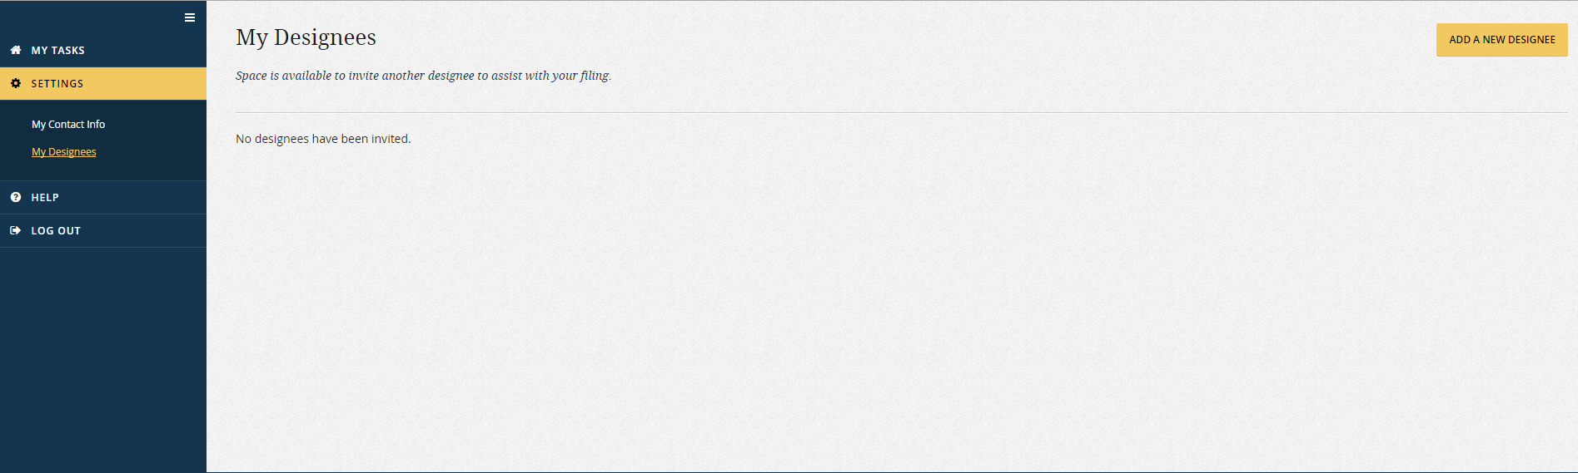
Adding a designee 2

Slide 16
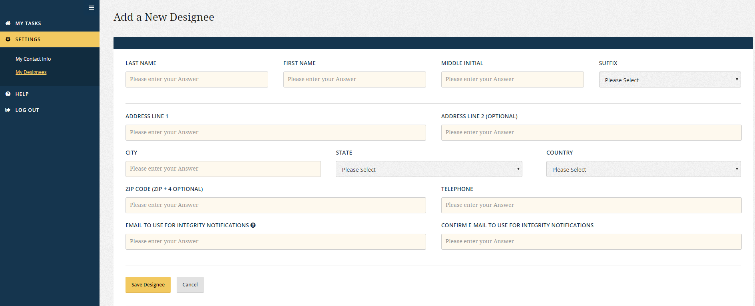
Adding a designee 3

Slide 17
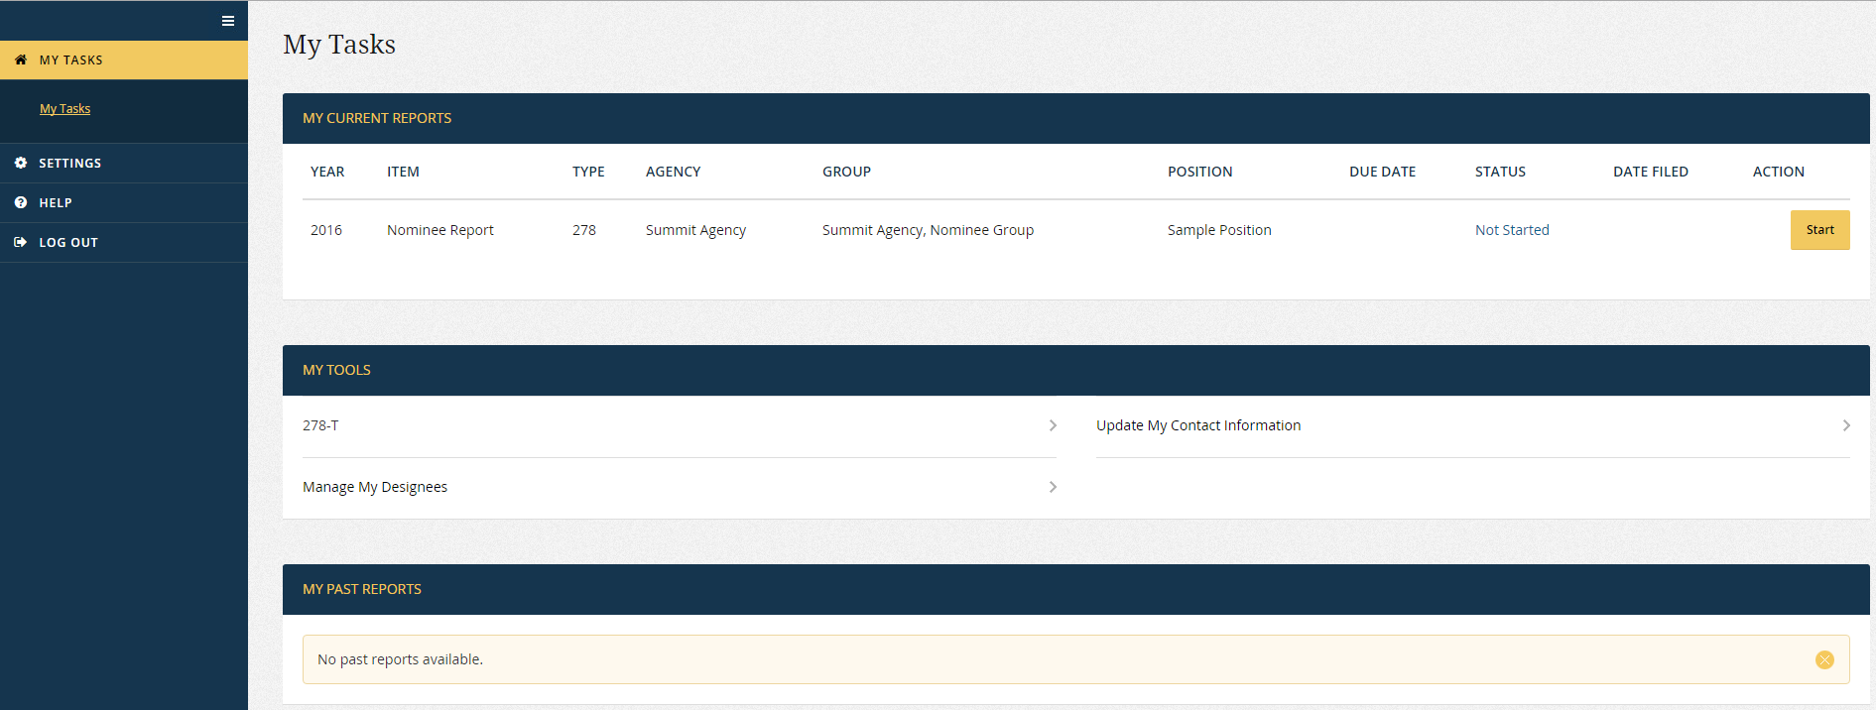
Opening the draft

Slide 18
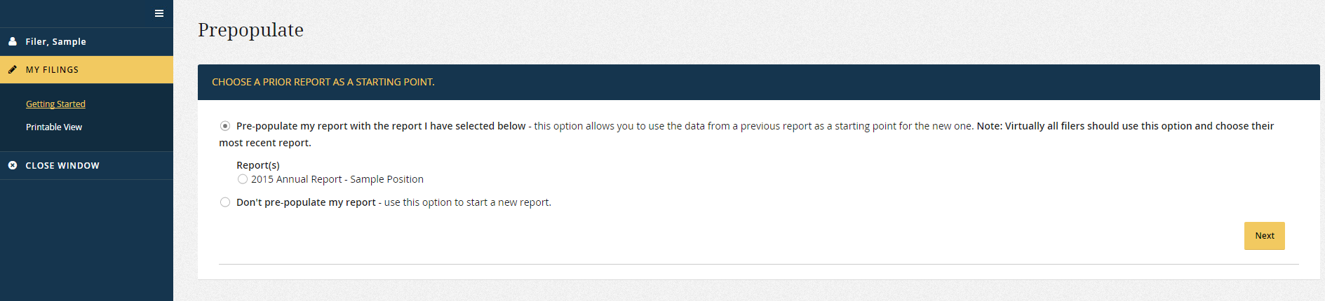
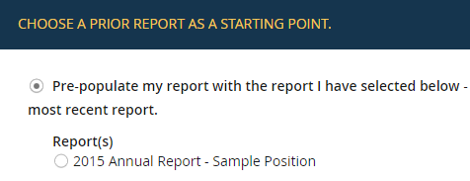
Pre-population?

Slide 19
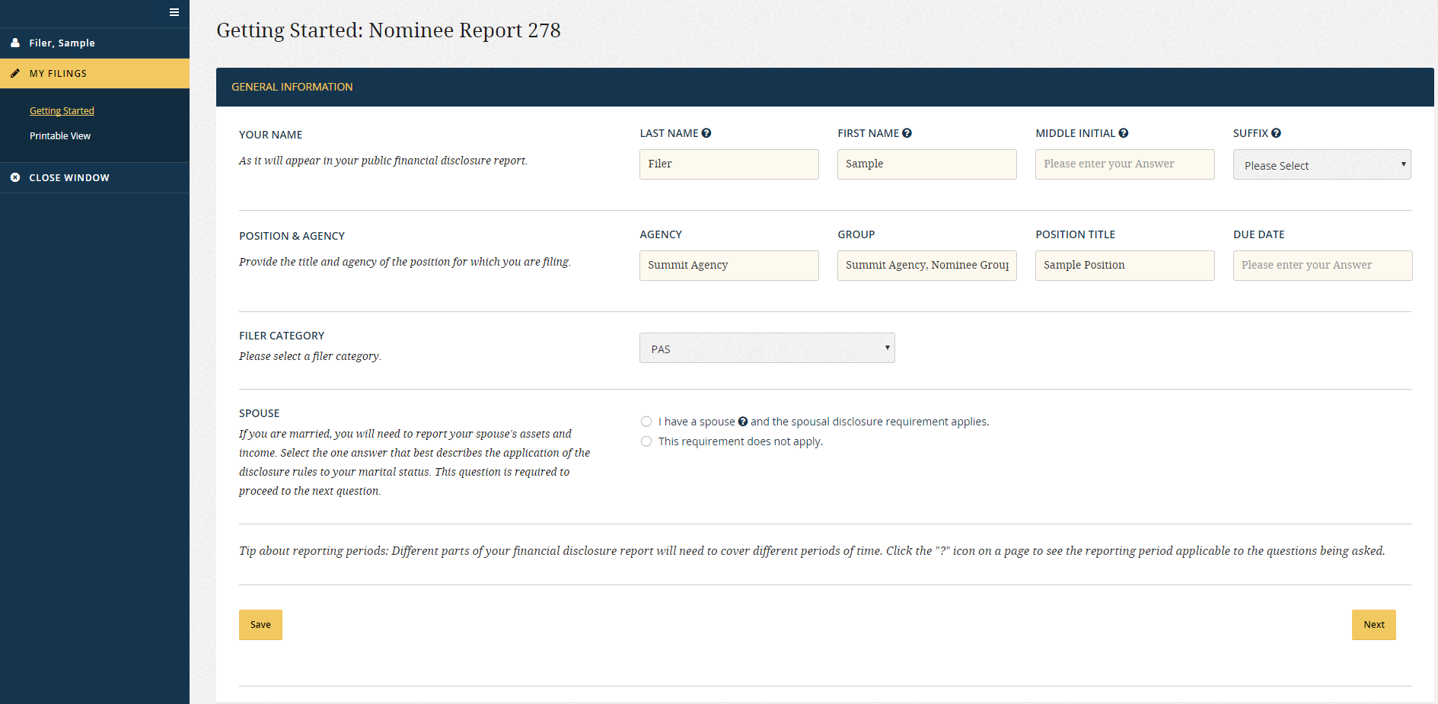
Getting started

Slide 20
Wizards and grids
Filers complete Nominee drafts in the same manner as a New Entrant report:
Prior Federal positions
Non-Federal positions
Wizard questions about assets/income related to those positions
Wizard questions about retirement plans/accounts
Data-entry tables for filer’s employment-related assets/income, agreements/arrangements, and sources of compensation
Wizard questions about assets/income related to spouse’s employment
Wizard questions about spouse’s retirement plans/accounts
Remaining data-entry tables

Slide 21
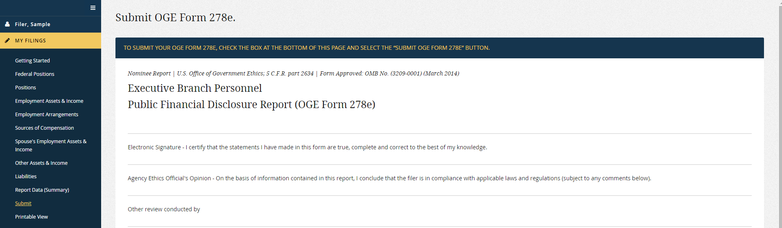
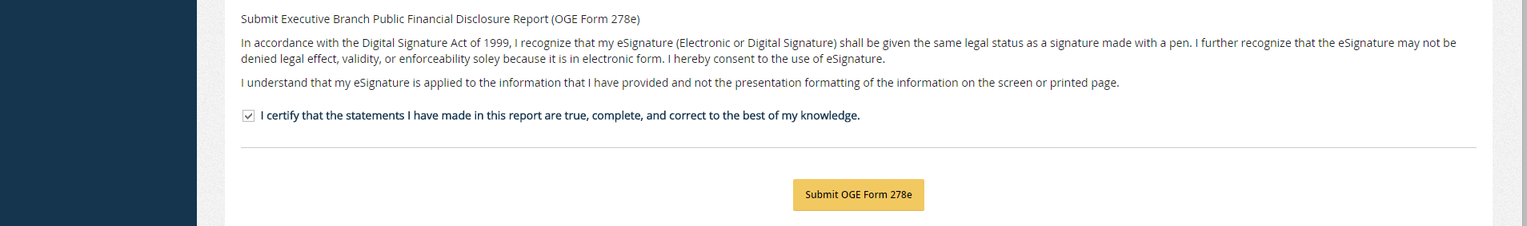
Submit draft

Slide 22
Releasing the initial draft

Slide 23
Release steps
PPO releases the draft to WHCO.
WHCO releases the draft to the agency and OGE at the same time.
Access rules:
Prior to PPO release: Only the filer and PPO can see the draft. Only the filer can edit the draft.
Prior to WHCO release, only the filer, PPO, and WHCO can see the draft. Only the filer can edit the draft.

Slide 24
OGE and agency review of the draft

Slide 25
Agency Nominee Group
Each agency within Integrity has 1 Nominee Group.
Roles for drafts:
Router (Primary): Receives notice of a released draft.
Router (Alternates): Can see a released draft.
Reviewers: Can see a draft after it is routed by a Router.
Records Manager: Can delete Nominee drafts/reports.
Roles for reports (after formal submission):
Depends on the agency’s PAS workflow.

Slide 26
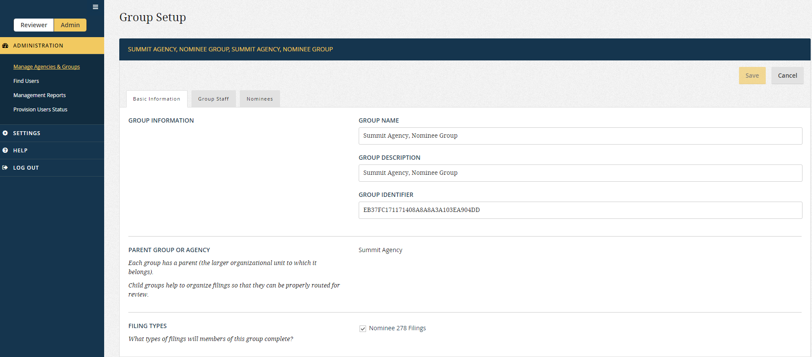

Slide 27
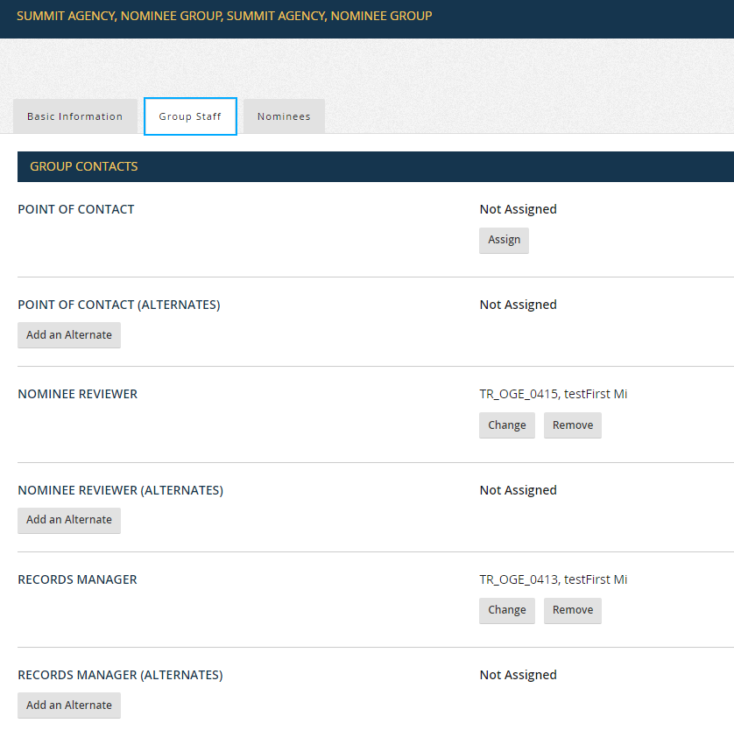

Slide 28
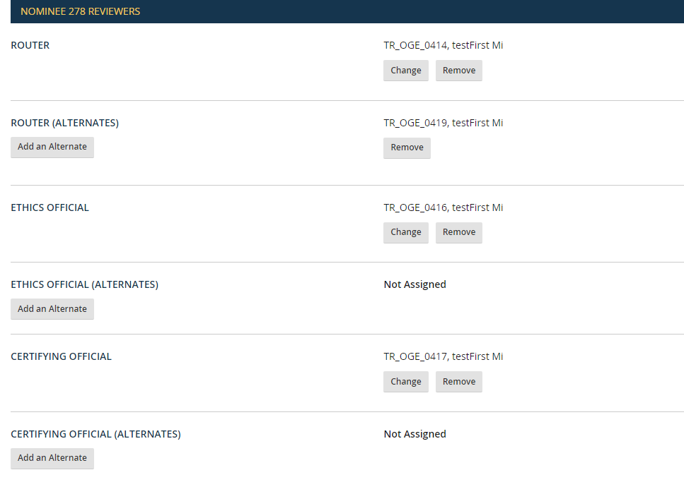

Slide 29
Receipt by router
Notice received by the Primary Router will follow the format of the agency’s “Report Pending Your Action” notice template.
Draft is “Assigned To” the Primary Router.
Alternate Routers must turn off the “Assigned To” filter to find the draft on the My Queue page.

Slide 30
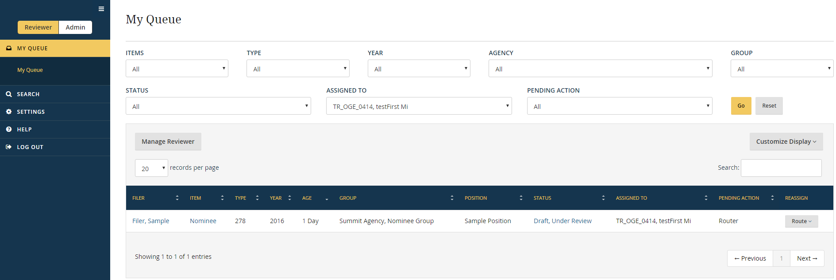

Slide 31
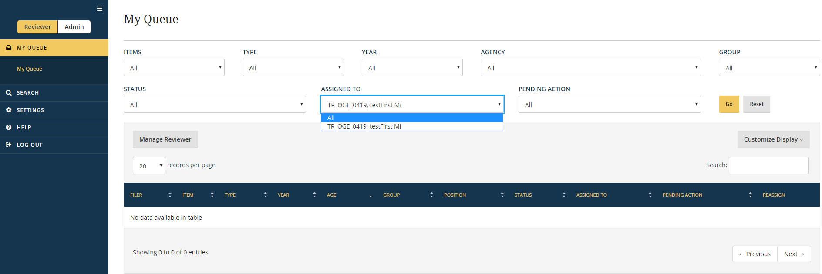

Slide 32
Route to reviewers
Routers grant Reviewers access to a draft by selecting the “Route” button.
Routing does not change the “Pending Action” or “Assigned To” status on the “My Queue” page.

Slide 33
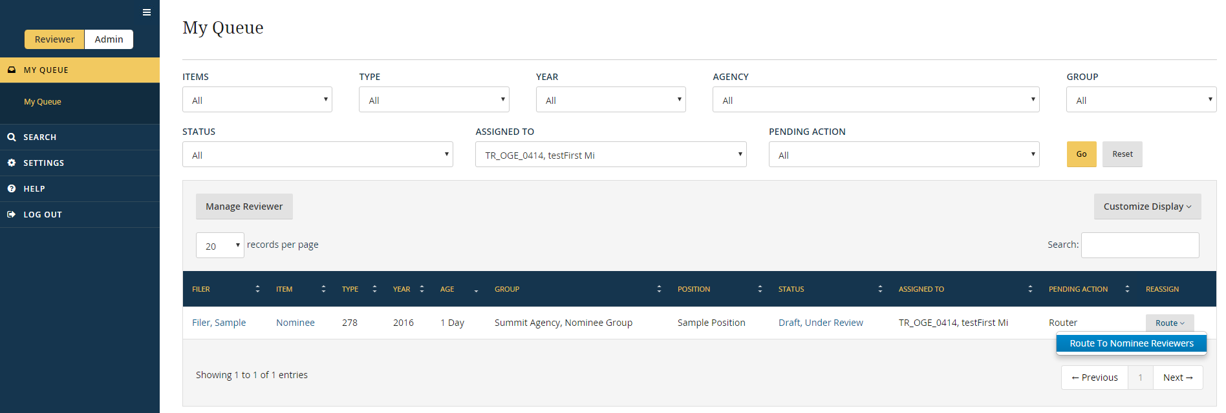

Slide 34
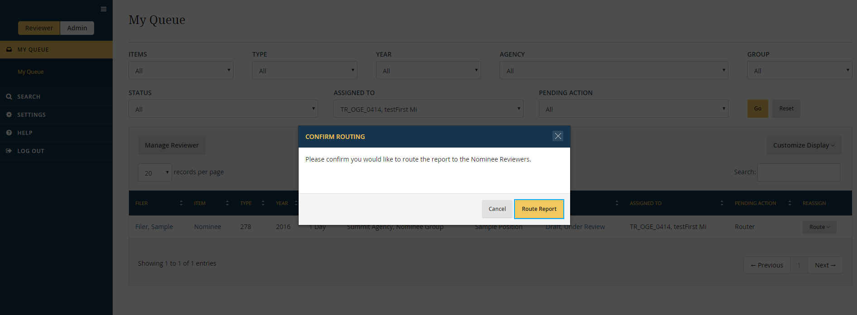
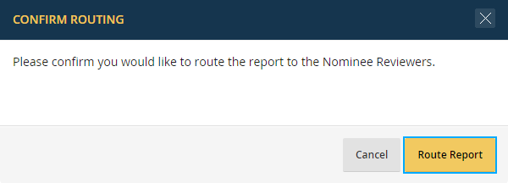

Slide 35
Assign a reviewer
At present, there is no “Reassign” button for Nominee drafts.
To assign a draft:
Go to the General Information page.
Enter the name in the “Agency Reviewer” field.
To check assignments on the My Queue page:
Open the “Customize Display” option.
Select “Agency Reviewer.”

Slide 36
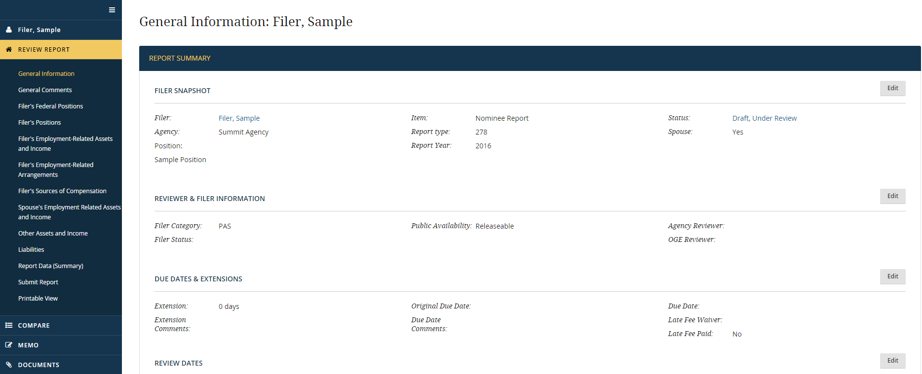

Slide 37
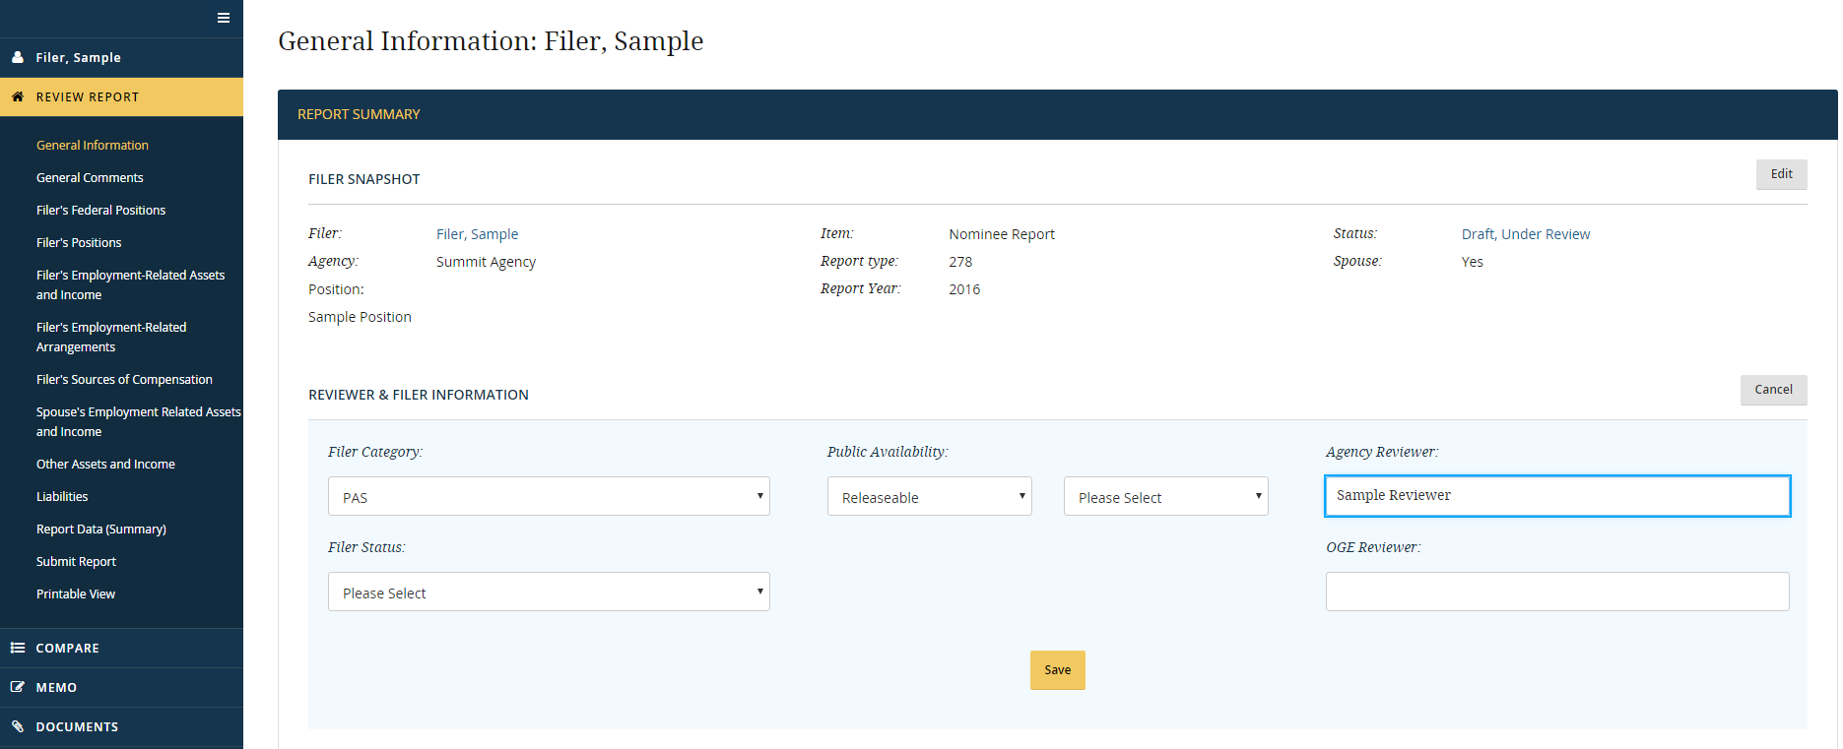
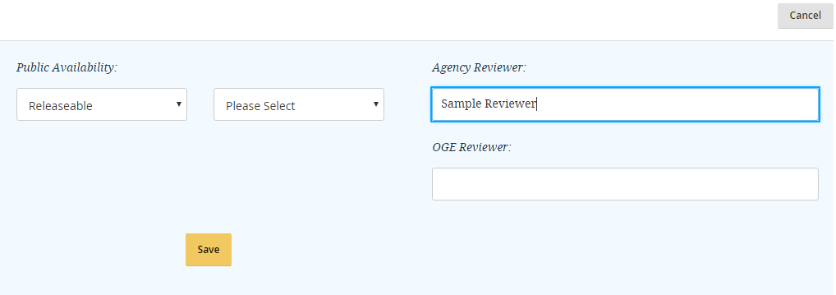

Slide 38
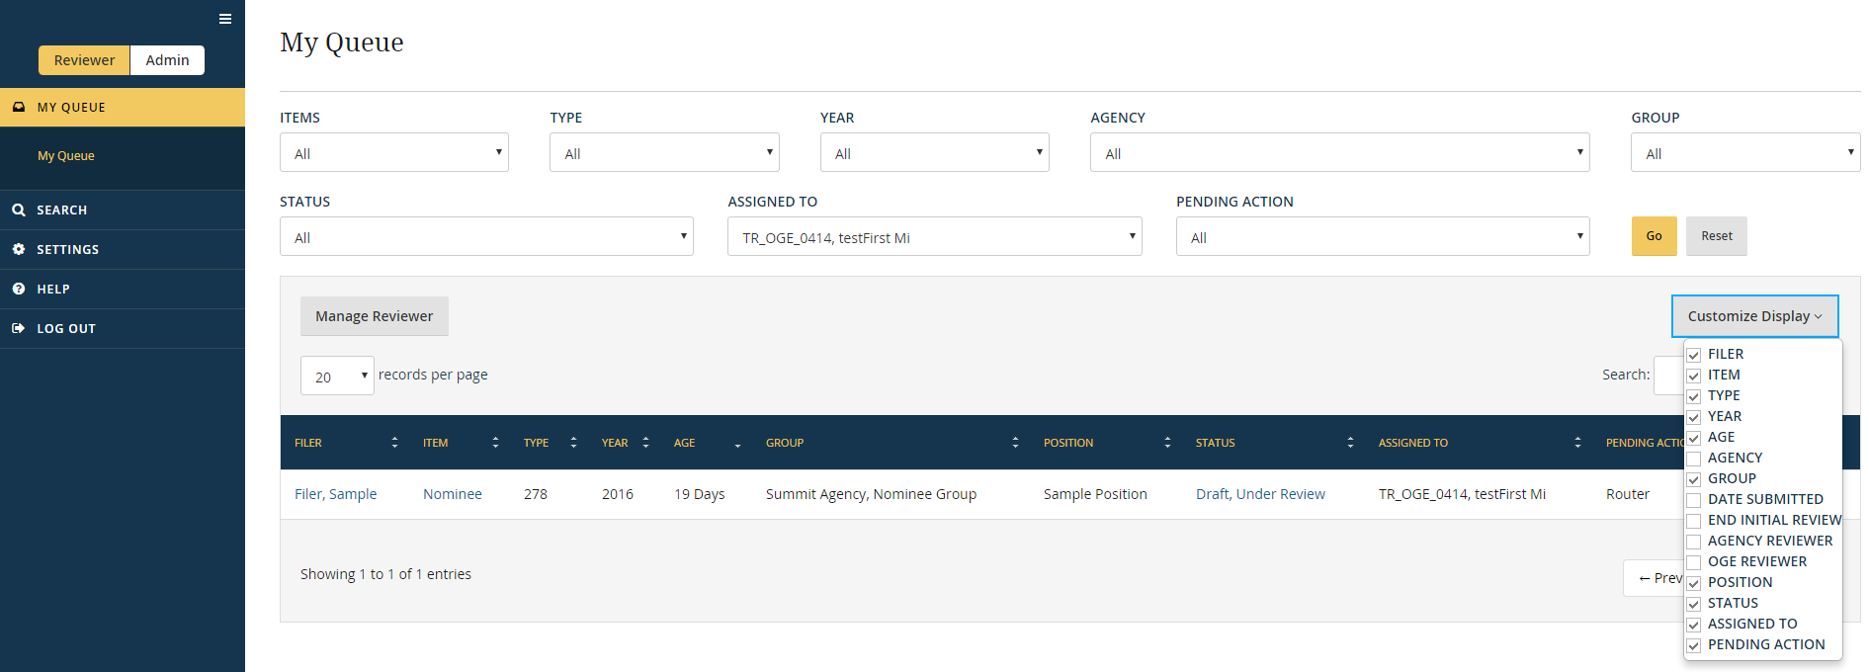

Slide 39
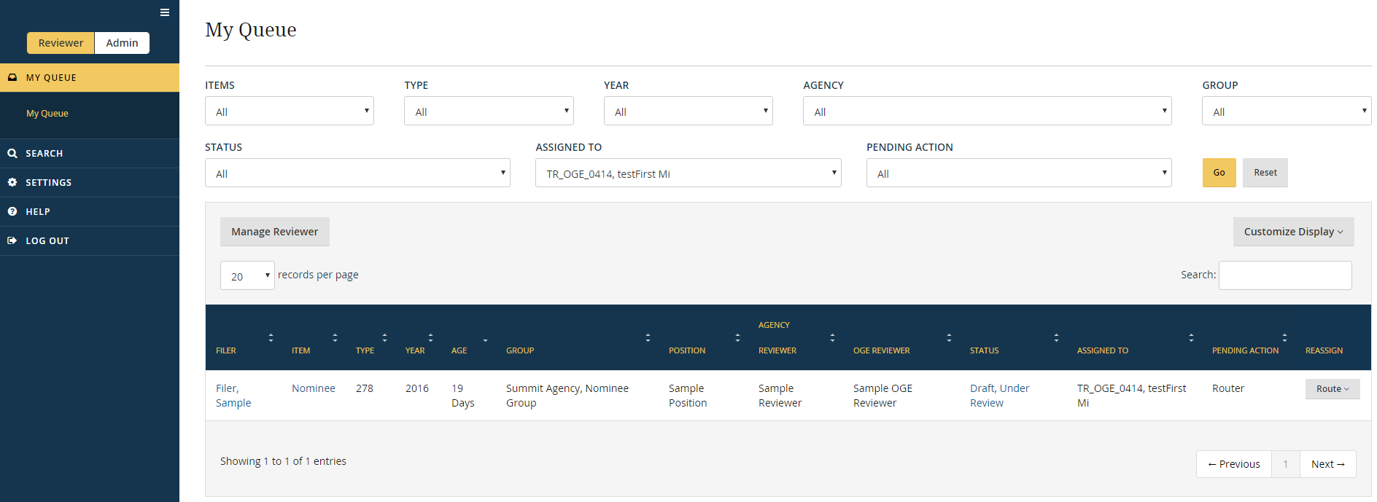

Slide 40
View a draft
Reviewers can view drafts in several ways:
One screen at a time
Report Data (Summary) page
Printable View page
To print a copy:
Go to Printable View.
Print directly from browser or select “Export to PDF” to obtain a PDF copy for later printing.

Slide 41
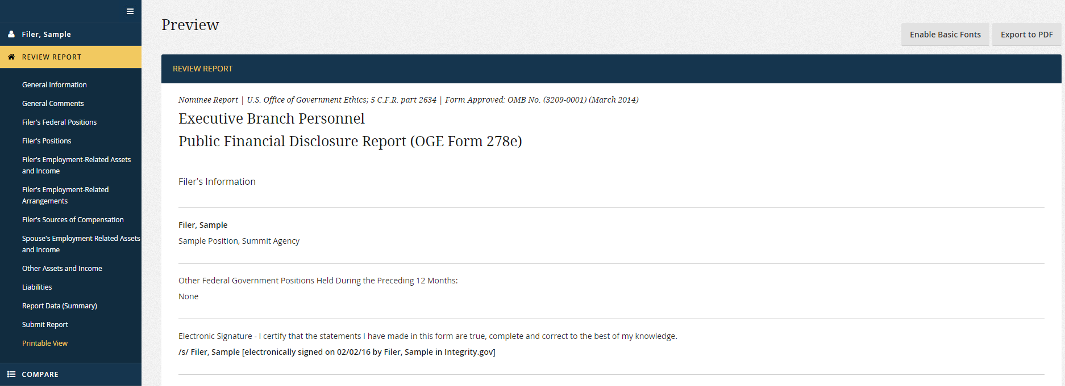
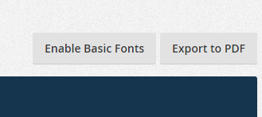

Slide 42
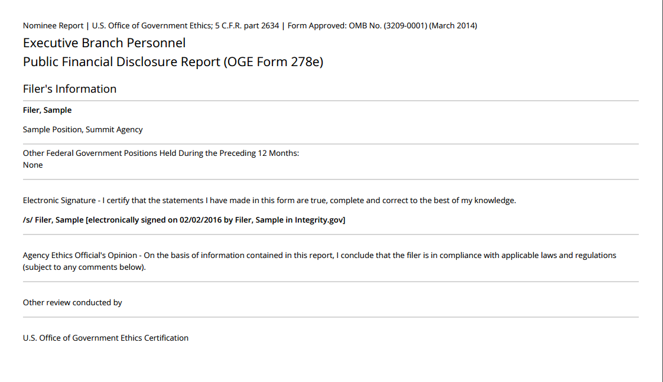

Slide 43
Comments
General Comments page: Used to make or respond to comments not tied to specific entries.
Line-entry comments: Used to make or respond to comments tied to specific entries.
Report Data (Summary) page: Displays all comments on the draft.
Notify filer or other reviewer of comments offline (e.g., call or email).

Slide 44
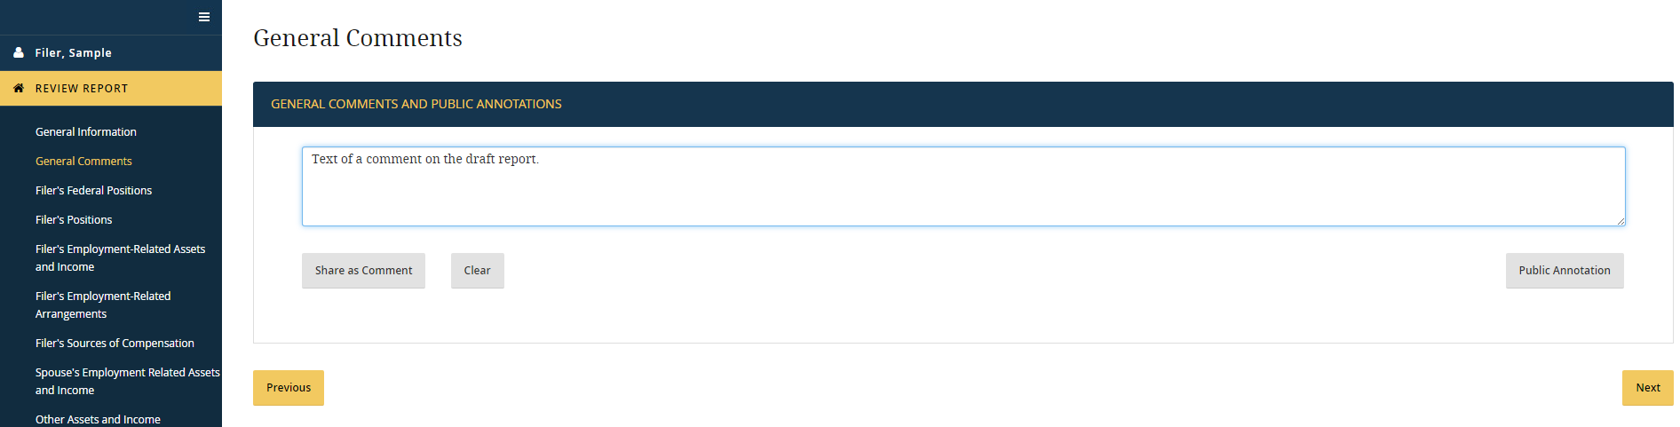
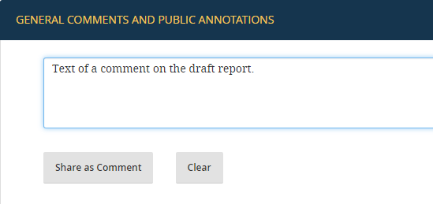

Slide 45
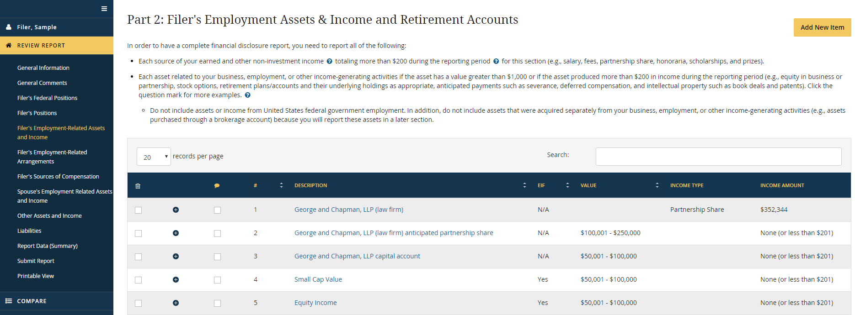

Slide 46
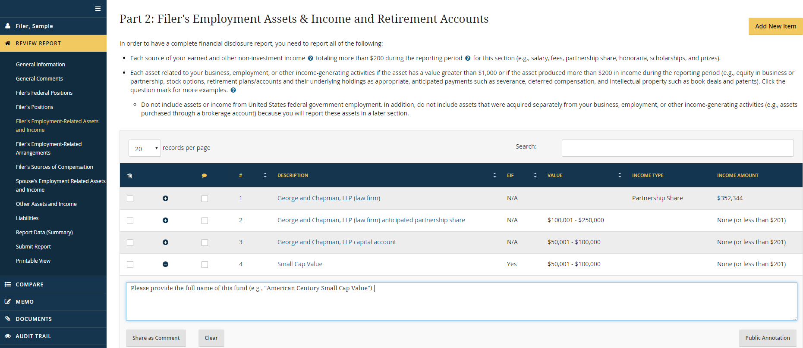
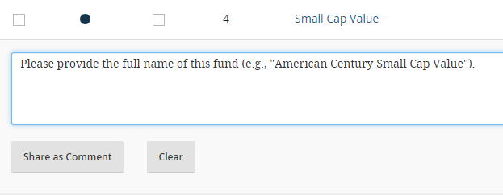

Slide 47
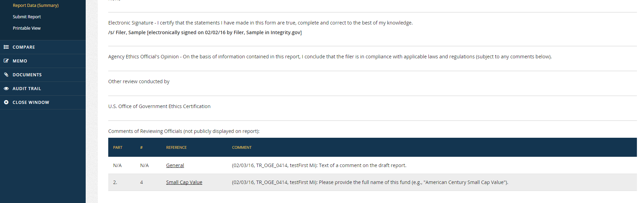
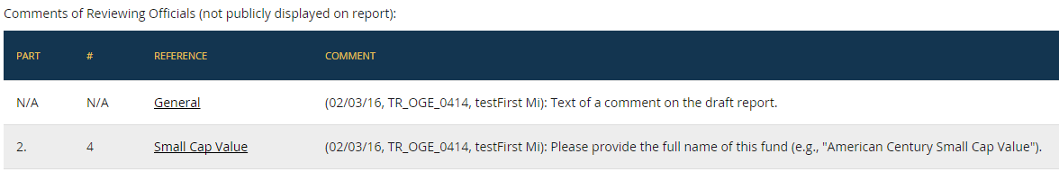

Slide 48
Editing
Unlike the workflow for other report types, the filer, agency, and OGE can edit a draft Nominee report in parallel.
No need to “return” a draft in order to permit edits by the filer. (Submit page is inactive.)
If two users are editing a draft, refresh the browser to see changes made by the other user.

Slide 49
Change History feature
Records workflow events and edits to entries between WHCO release and the filing of the formal report.
Use this feature to check for changes since the last time you opened the draft.

Slide 50
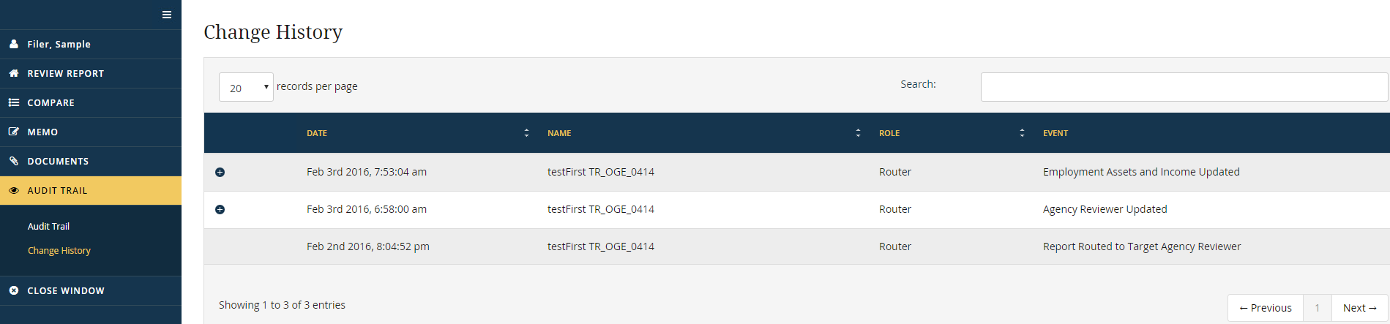
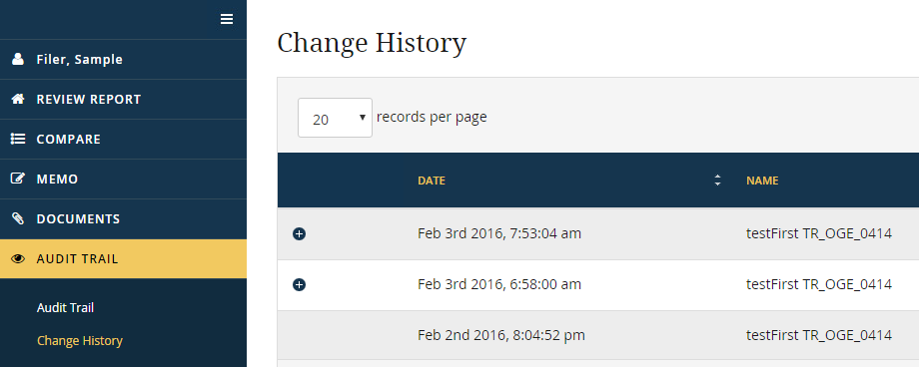

Slide 51
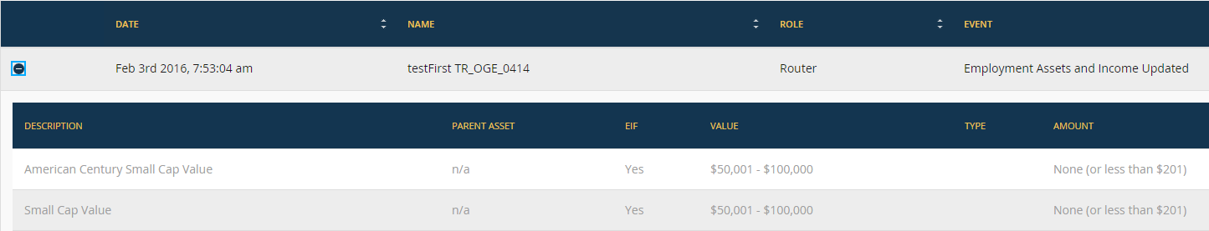
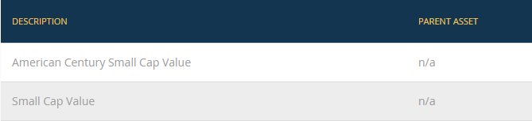

Slide 52
Other features
Documents: Can upload the ethics agreement and other materials.
Memo: Can save searchable reviewer notes.
Compare: Can see differences between the Nominee draft and a prior report (if pre-population was used).

Slide 53
Ready for preclearance?
OGE Nominee Reviewer forwards the draft to the OGE Program Manager for preclearance.
No agency workflow action is needed.
If you wish to tell OGE that the draft is ready from your perspective, call or email the reviewer.

Slide 54
Preclearance to certification

Slide 55
Before nomination
Filer can edit a precleared draft if necessary.
Changes are recorded in Change History.
Filer cannot officially file a report until OGE enters the nomination date on the General Information page.

Slide 56
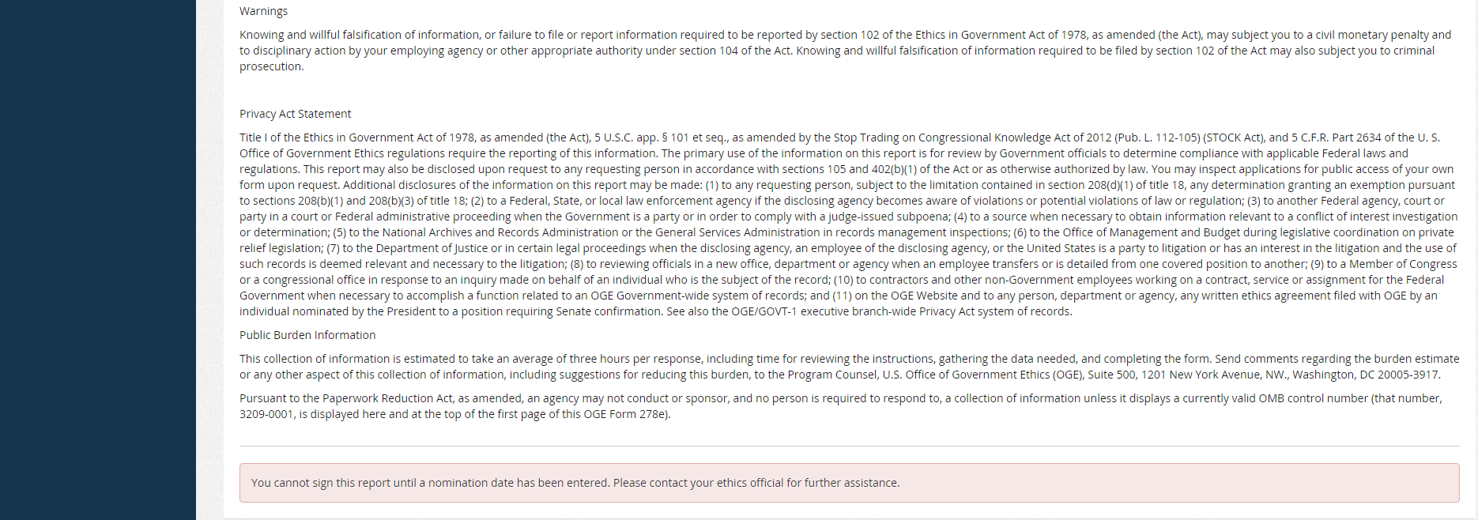

Slide 57
Final submission
OGE will inform the agency that the nomination date has been entered.
Filer opens the draft, goes to the “Submit” page, checks the certification statement, and clicks the “Submit” button.
Status changes from “Draft” to “Report.”

Slide 58
Signature dates
Filer’s submission of the official report is recorded in the Audit Trail.
Printed OGE Form 278e displays the original signature date from the draft because that date reflects the reporting period used.
If the reporting period needs to be updated, OGE will use the (pending)“update” feature, which changes the displayed signature date.

Slide 59
Final review
Notice will be sent to the Primary for the first role in the PAS report workflow (e.g., the Screener).
Report will go through the standard PAS workflow for the agency, using the role holders specified for the Nominee Group.
Once the agency certifies, the report goes to OGE for certification.
Audit Trail records any edits to the report between formal submission and certification.

Slide 60
After certification

Slide 61
Effects of certification
Report data entry tables are removed.
User can view the report through Report Data (Summary) or Printable View only.
Comments are removed.
Change History is cleared of data edit events.

Slide 62
Once confirmed
OGE enters the confirmation date, which prevents report from being purged/deleted until the end of the 6-year retention period.
Agency:
Shares the Nominee report with the filer’s “home” Group.
(if applicable) Adds the filer to Integrity with a new agency email address.
(if applicable) Requests that the Integrity Helpdesk merge the filer’s prior account with the account for the new agency email address.

Slide 63
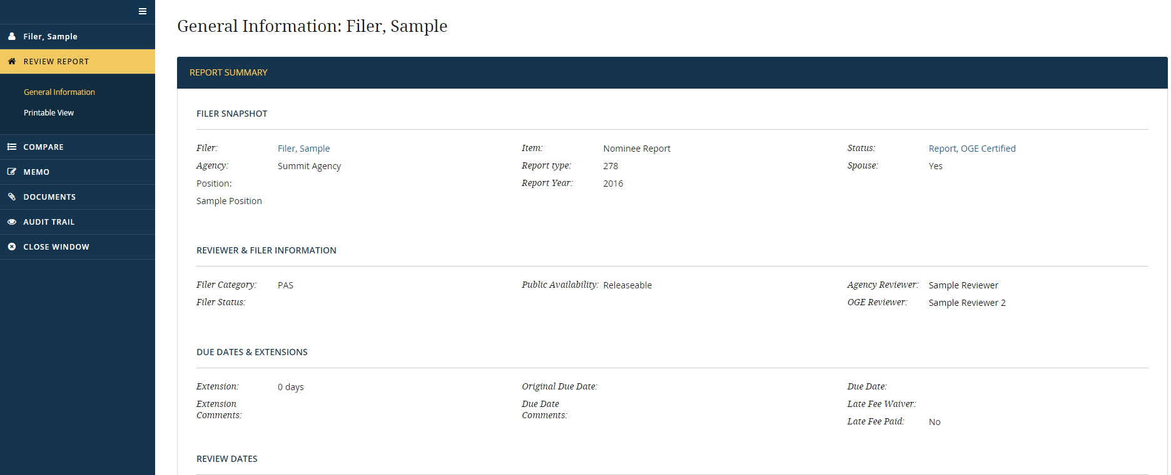

Slide 64
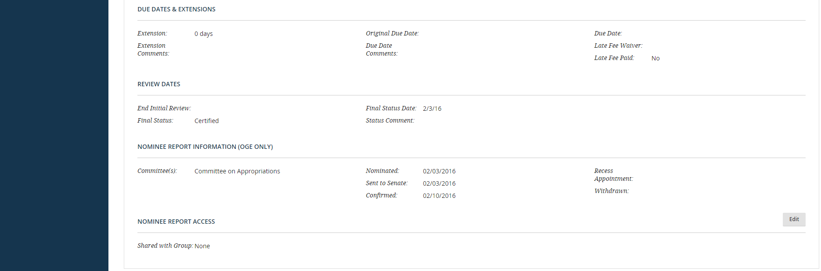
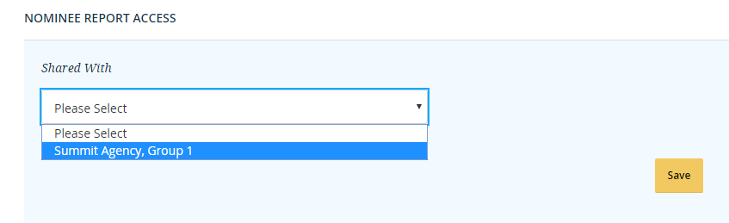

Slide 65
If not confirmed
OGE will remove the report 1 year after the filer is no longer under consideration by the Senate.

Slide 66
Quick summary
One Nominee Group per Integrity agency
Draft: Router, Reviewer, and Records Manager
Report: Reviewer roles for PAS reports at your agency
Filer ID: Existing ID if in Integrity; otherwise, cloaked
Access to the draft:
No OGE or agency access before WHCO release
Parallel access for filer, agency, and OGE after WHCO release
Change History log shows who changed the draft
“Signature date” is the draft submission date, unless the draft is subject to the update process
After OGE certification: No changes to the report; Clear draft history
After confirmation: Add the filer to a Group, share the report, and, if necessary, merge accounts

Slide 67


